Slide 1
Statistics and Probability
Analysis of McDonalds
Nutritional Facts

Slide 2
PROBLEM ANALYSIS
The dataset has the following components for analysis:
Applying the concepts of Exploratory Data Analysis.
Trying to find out combos of the various categories with balanced calorie content.
Analyzing the sugar intake and guessing the chances of getting Diabetes via Bayes Theorem.
Analysing the Sodium intake and guessing the chances of getting Thyroid via Bayes Theorem.
Analysing the protein requirements that can be provide by the food in the menu.
Analysing other essential nutrients present in the menu items.
Plotting Scatter plot to find correlation between Carbohydrates and Cholesterol.
Using Hypothesis testing to try to get food items with safer carbohydrate intake.

Slide 3
PROBLEM ANALYSIS
Here there are many statistics and probability concepts used: -
Calculation of mean and variance
Plotting different graphs
Plotting of PMF and CDF
Bayes Theorem
Hypothesis Testing
Modeling Distribution
Exploratory Data Analysis

Slide 4
PROBLEM DESIGN
The dataset mainly focus on the nutritional value present in the menu items.
Applying EDA concepts:-
The dataset is first read using the pandas data frame and then validated and transformed.
The data is checked for null values.
The number of columns are calculated for ensuring no errors are present while importing the dataset.

Slide 5
PROBLEM DESIGN
Using different plots to analyse different aspects of the dataset:-
The barplots and scatter plots are used for determining components like Calories, Iron,Vitamins,etc.
The plots help in establishing correlation between nutrients and cholesterol level to different negative effects from positive ones.
The categories are analysed based on these nutrients for a better understanding of the nutritional value.
Plotting PMF and CDF graphs and modeling distributions:-
The PMF(Probability Mass Function) graphs are plotted in order to make the different nutrient values quantifiable and estimating their probabilities.
The CDF(Cumulative Distribution Function) graph helps in differentiating the regions of high probabilities from that of lower probabilities.
Modeling distributions helps in identifying the coreect form of distribution required for the data(Normal, Exponential, Lognormal, etc.).

Slide 6
PROBLEM DESIGN
Applying Bayes Theorem: -
In the imported data set Bayes Theorem is used for determining the chances of catching any severe disease like diabetes and thyroid.
The Sodium and sugar intake of the different menu items are calculated and then compared with the facts gathered which finally gives us a probability of getting diagnosed with them due to the fast food consumption.
Using Hypothesis Testing: -
Hypothesis testing is used for trying to determine some safer consumption options in the McDonalds menu.
A random sample selected from the population is analysed based on the facts gathered and using Z score as a medium to prove the hypothesis formed.

Slide 7
PROGRAMMING REQUIREMENTS
There are various functional requirements for the program:
The program is constructed in Python 3 and uses various libraries in order to execute data visualization and helps in building the data frames. The libraries used for this purpose are:
Matplotlib
Numpy
Pandas
Seaborn
The Thinkplot and Thinkstats2 libraries provided the desired functions for plotting the PMF and CDF graphs.
The sklearn.utils library contains the resample to ensure that the selection bias is avoided and the values selected for the sample are random.
The scipy library provided the modules for calculating the Z score.

Slide 8
PROGRAM STEPS
The first step is importing the data using data frame via pandas library.
After importing the dataset, check if there is any error while importing by checking the head and tail of the data set.
Then check for null values and if any transformation is required in the dataset.
Finally begin with the analysis on different components of the data set.
Analyse the calorie content of different categories via barplot and try to make different combinations.

Slide 9
PROGRAM STEPS
Then analyse the salt and sugar intake followed by the application of bayes theorem to guess the chances of catching Thyroid or diabetes.
The next analysis to be done on protein intake and how much requirement is the menu capable of fulfilling and analyse its distribution modeling.
Then comes analyzing the essential nutrients like the iron, vitamins, dietary fiber, etc.
Finally plot a scatter to analyse the correlation between the carbohydrates and cholesterol levels and verify your finding using hypothesis testing.

Slide 10
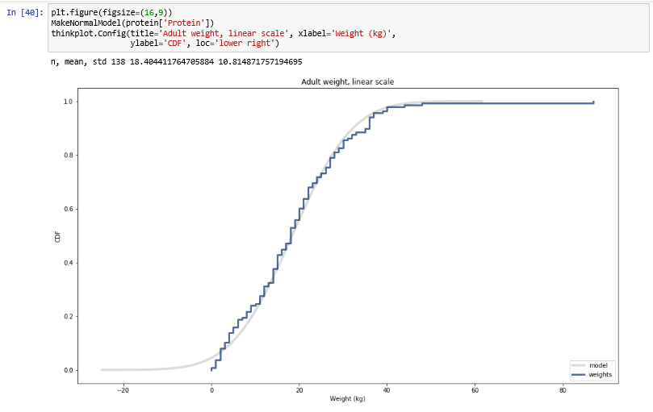
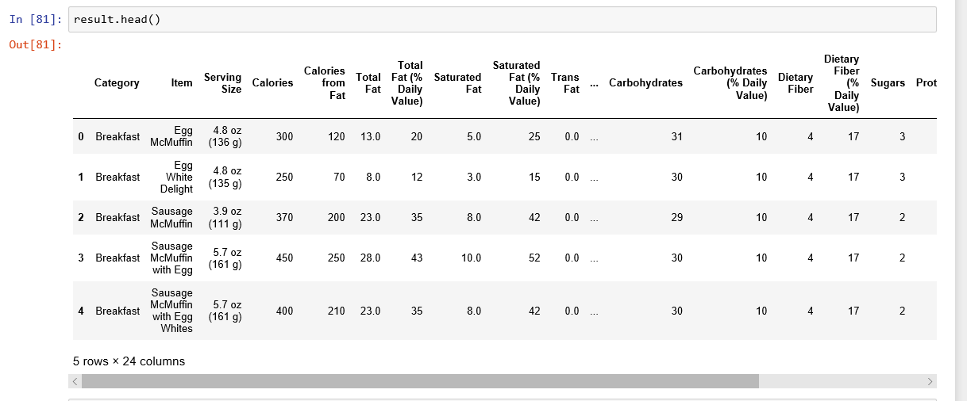
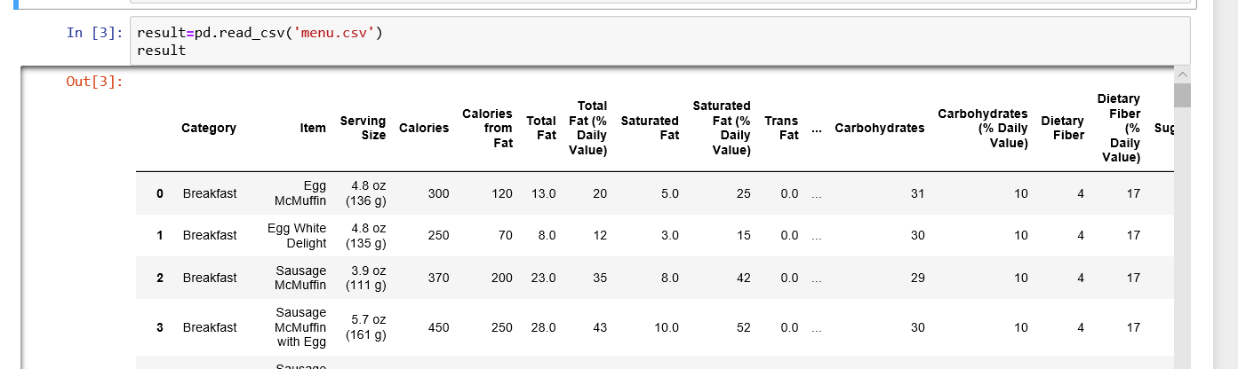
OUTPUT

Slide 11
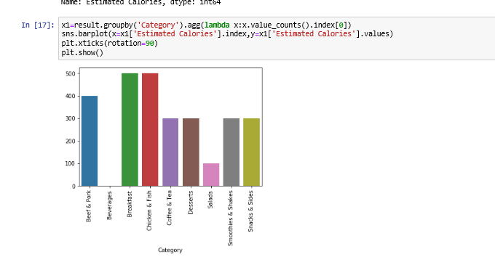
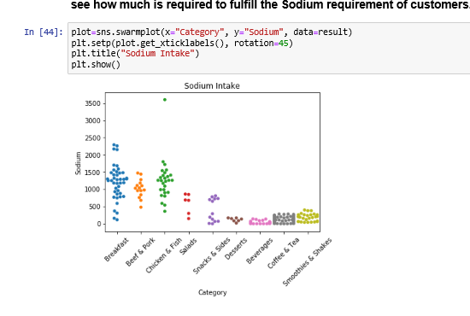
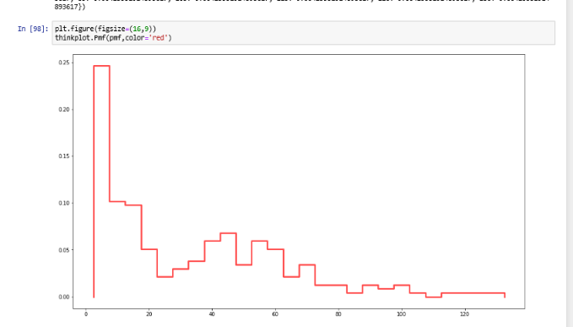
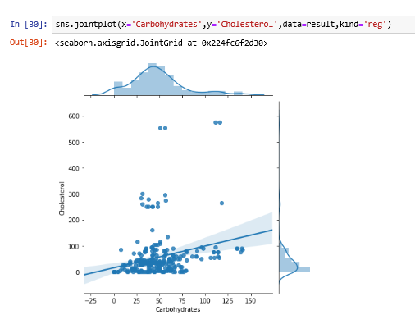
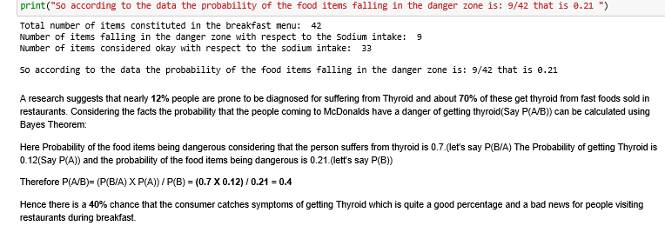
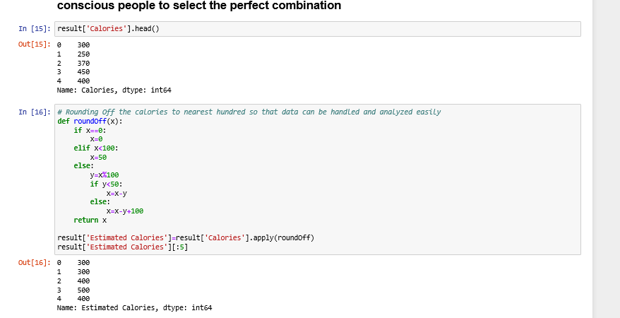
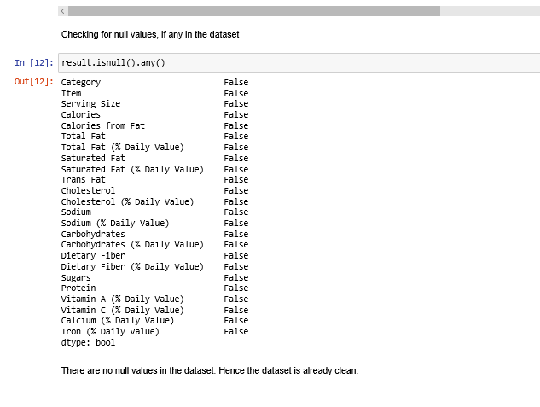
OUTPUT

